Slide 1
The Gaming Community.
Under the guidance of: Prachiti Ma’am.

Slide 2
Abstract.
My SQL project showcases the current situation of the Gaming Community. The indian gaming community is one of the fastest growing career option among the indian youth.

Slide 3
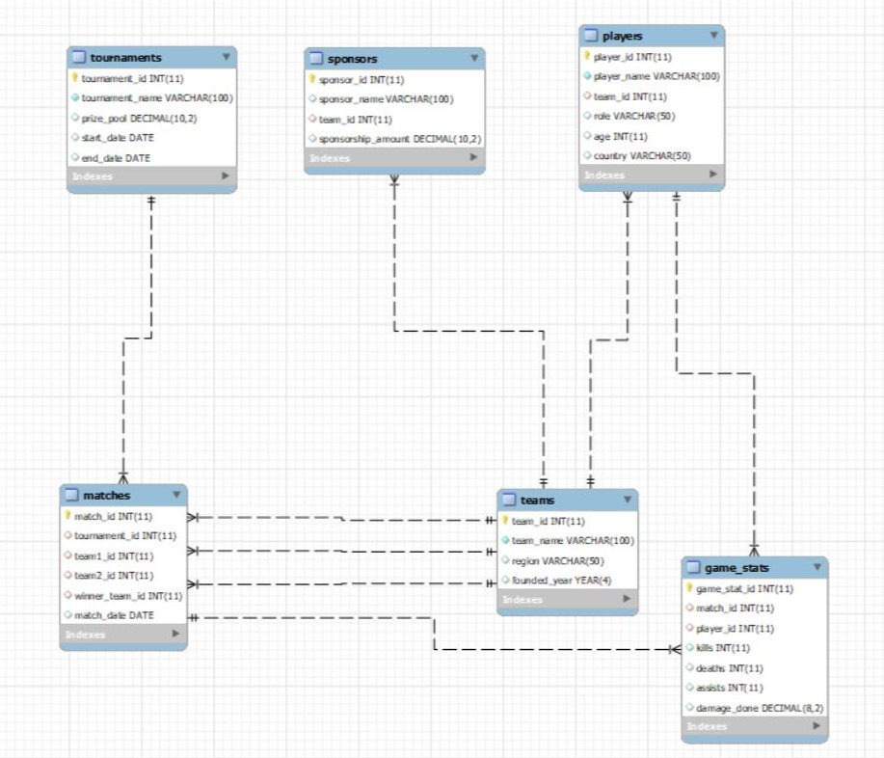
ER- Diagram

Slide 4
Structure of the Tables

Slide 5
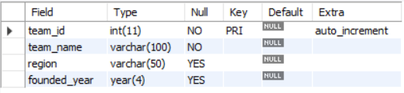
Teams Table Desc Teams;

Slide 6
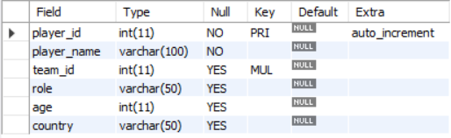
Players Table Desc Players;

Slide 7
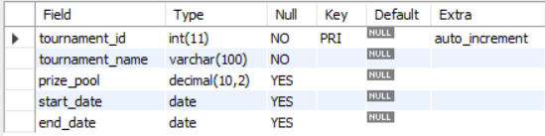
Tournaments Table Desc Tournaments;

Slide 8
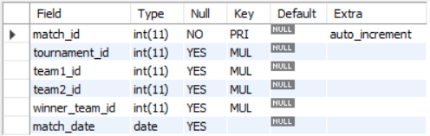
Matches Table Desc Matches;

Slide 9
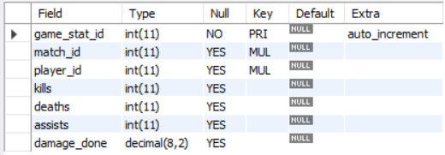
Games_Stats Table Desc Game_Stats;

Slide 10
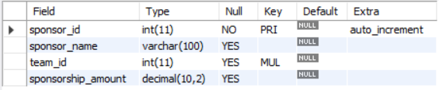
Sponsors Table Desc Sponsors;

Slide 11
Contents of the tables

Slide 12
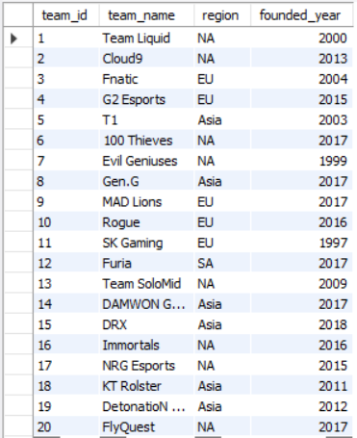
Teams Table Select * from Teams;

Slide 13
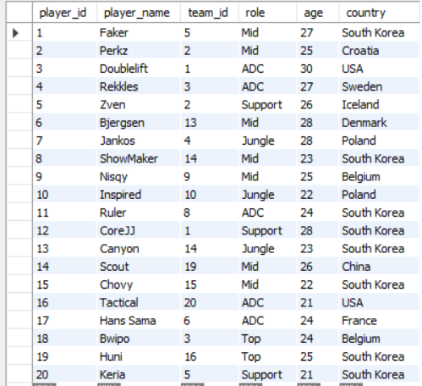
Players Table select * from Players;

Slide 14
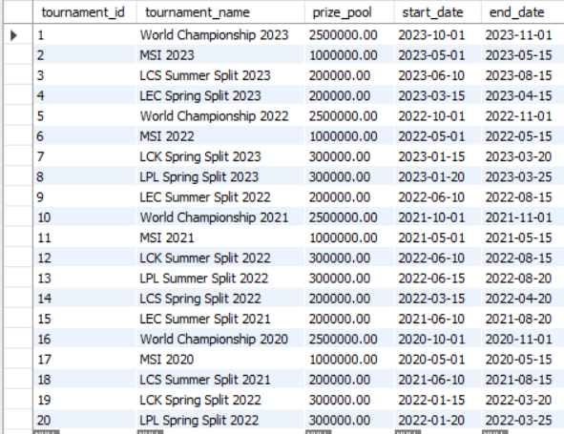
Tournaments Table Select * from Tournaments;

Slide 15
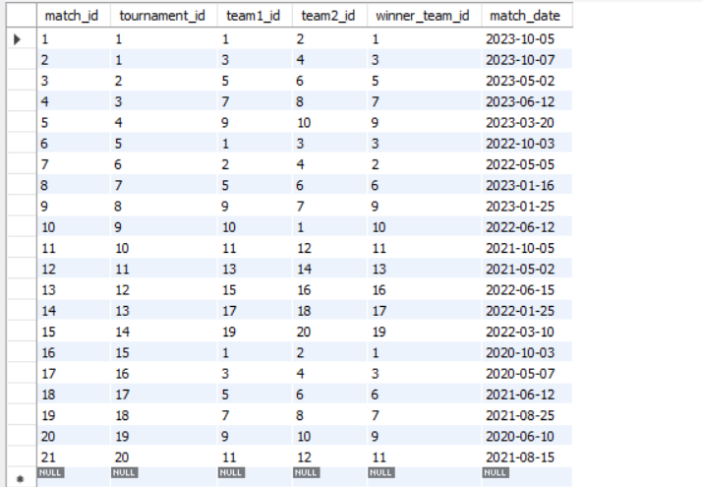
Matches Table Select * from Matches;

Slide 16
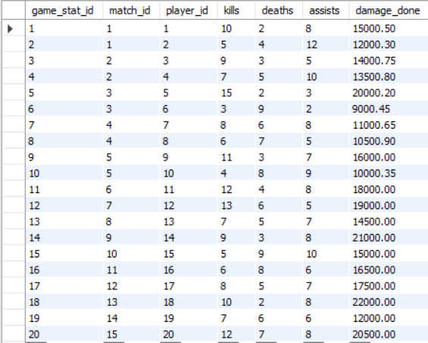
Game_Stats Table Select * from Game_Stats;

Slide 17
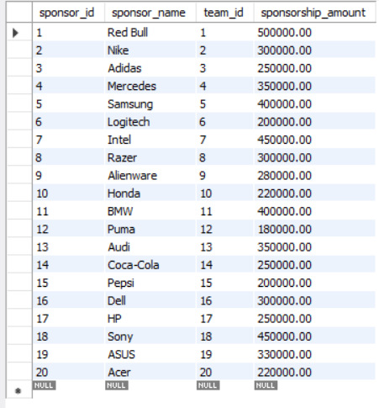
Sponsors Table Select * from Sponsors;

Slide 18
SUB- QUERIES

Slide 19
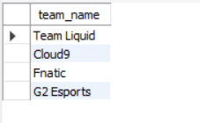
Teams Participating in a Tournament
SELECT team_name FROM Teams WHERE team_id IN ( SELECT team1_id FROM Matches WHERE tournament_id = 1 UNION SELECT team2_id FROM Matches WHERE tournament_id = 1);

Slide 20
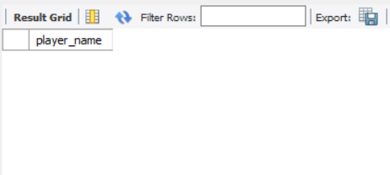
Players Without Sponsors
SELECT player_name FROM Players WHERE team_id NOT IN (SELECT team_id FROM Sponsors);

Slide 21

Total Prize Pool of Tournaments a Specific Team Participated In
SELECT SUM(prize_pool) FROM Tournaments WHERE tournament_id IN ( SELECT tournament_id FROM Matches WHERE team1_id = 1 OR team2_id = 1);

Slide 22
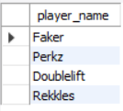
Players Who Played in a Specific Tournament
SELECT player_name FROM Players WHERE player_id IN ( SELECT player_id FROM Game_Stats WHERE match_id IN ( SELECT match_id FROM Matches WHERE tournament_id = 1 ));

Slide 23
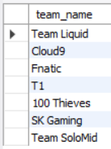
Teams with Prize Pool Above the Average Prize Pool.
SELECT team_name FROM Teams WHERE team_id IN ( SELECT winner_team_id FROM Matches m JOIN Tournaments t ON m.tournament_id = t.tournament_id WHERE t.prize_pool > (SELECT AVG(prize_pool) FROM Tournaments));

Slide 24
JOINS

Slide 25
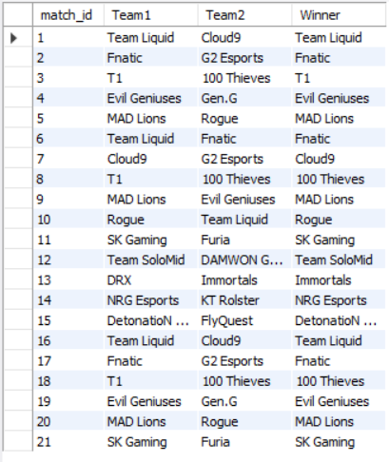
List All Matches with Teams and Winners
SELECT m.match_id, t1.team_name AS Team1, t2.team_name AS Team2, w.team_name AS Winner FROM Matches m JOIN Teams t1 ON m.team1_id = t1.team_idJOIN Teams t2 ON m.team2_id = t2.team_id JOIN Teams w ON m.winner_team_id = w.team_id;

Slide 26
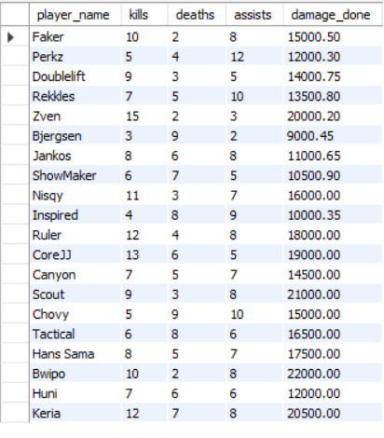
Display match Stats of players
SELECT p.player_name, g.kills, g.deaths, g.assists, g.damage_done FROM Game_Stats g JOIN Players p ON g.player_id = p.player_id;

Slide 27
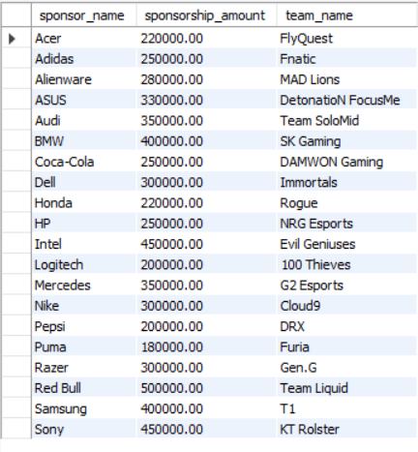
Find All Sponsors and Their Associated Teams with sponsorship amount
SELECT s.sponsor_name, s.sponsorship_amount, t.team_name FROM Teams t RIGHT JOIN Sponsors s ON t.team_id = s.team_id ORDER BY s.sponsor_name;

Slide 28
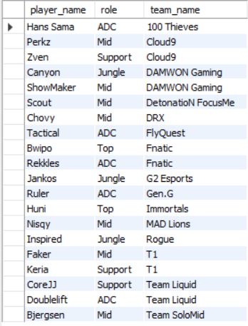
Find All Players and Their Teams
SELECT p.player_name, p.role, t.team_name FROM Players p INNER JOIN Teams t ON p.team_id = t.team_id ORDER BY t.team_name, p.player_name;

Slide 29
VIEWS

Slide 30
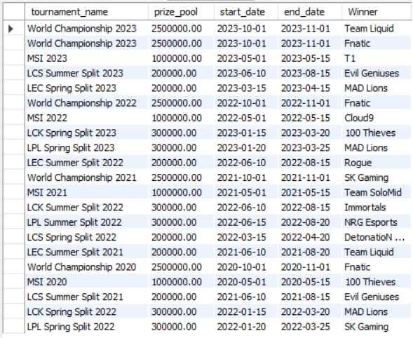
Create View for Tournament Details
CREATE VIEW Tournament_Details AS SELECT tn.tournament_name, tn.prize_pool, tn.start_date, tn.end_date, t.team_name AS Winner FROM Matches m JOIN Tournaments tn ON m.tournament_id = tn.tournament_id JOIN Teams t ON m.winner_team_id = t.team_id;

Slide 31
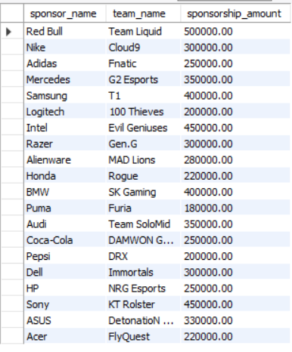
Create View for Sponsor Information
CREATE VIEW Sponsor_Info AS SELECT s.sponsor_name, t.team_name, s.sponsorship_amount FROM Sponsors s JOIN Teams t ON s.team_id = t.team_id;
Select * from Sponsor_Info;

Slide 32
Thank You

Slide 33
Prepared By
VIDHIT SHETH
T/324 DS & DA with AI.

